Slide 1

How to Do Historical Research and Analysis
Native American Expulsion and Westward Expansion in the Nineteenth Century

Slide 2
Content Warning
This lesson discusses genocide, murder, mutilation, violence, discrimination, and racism.

Slide 3
Essential Research Questions
What and who were the driving forces behind the removal of Native Americans from their lands?
Why did people advocate for the expulsion of Native Americans?
How did Native Americans respond to forced expulsion?
How did the system of slavery impact US policy regarding Native Americans and their lands?
What legal methods and processes were used to dispossess Natives of their lands?
How do the Indian Removal Act of 1830 and the forced expulsion of Native Americans impact the United States today?

Slide 4
Doing Historical Research
What kinds of sources are necessary to consult while conducting research about Native American removal from the Deep South?
Primary Sources: laws such as the Indian Removal Act; records from the Bureau of Indian Affairs; treaties such as the Treaties of Indian Springs and the New Echota Treaty; newspaper articles from The Cherokee Phoenix; reports from government officials; letters from Native Americans to the federal government
Secondary Sources: historical monographs (books) that cite primary sources, such as Unworthy Republic: The Dispossession of Native Americans and the Road to Indian Territory by Claudio Saunt; analysis or interpretation of data; scholarly articles, such as "American Indian Removal Beyond the Removal Act" by John P. Bowes in Native American and Indigenous Studies (University of Minnesota Press)
Where are these primary sources?
How can we access both primary and secondary sources?
What are archives? Why do archives exist? How can we access and utilize them as researchers?
How do we evaluate sources for historical evidence while also considering perspectives and motivations of the sources' authors?

Slide 5
Primary Source Analysis Activity
Use the provided worksheet to:
Identify the source.
Identify the author/creator.
Identify the author's point-of-view/position on the issue addressed in the source.
Analyze the information in the source.
Keep in mind these questions:
What are the author's motivations for creating this document/source?
Is there any information the author is misrepresenting to the reader? If so, why do you think the author did this?
Why is the author's position or point-of-view expressed in the document/source important to understanding forced removal of Native Americans?

Slide 6
Post-Activity Class Discussion
Each group will answer these questions:
What kind of source is this (speech, military order, treaty, newspaper article, etc.)?
Who wrote or created this source?
Who is the audience the author is addressing?
What is the author's argument?
Is there any information the author is misrepresenting to the reader? If so, why do you think the author did this?
Why is the author's position or point-of-view expressed in the document/source important to understanding forced removal of Native Americans?
Compare this text to the other primary sources given. What are the differences, and how might those differences show the “full” history of this historical process?

Slide 7
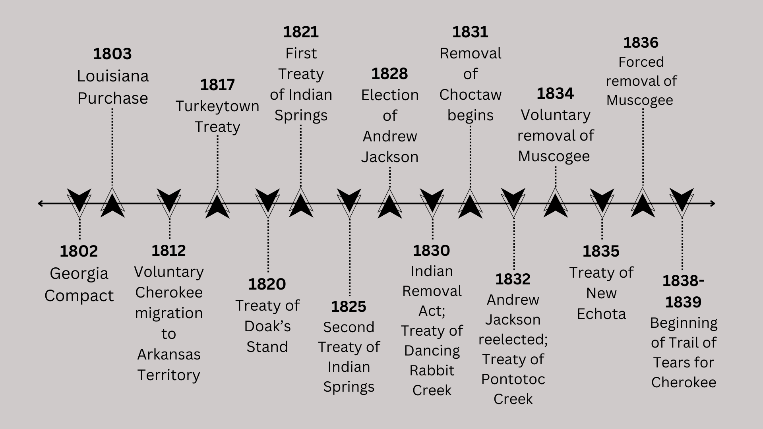
Native American Expulsion Timeline

Slide 8
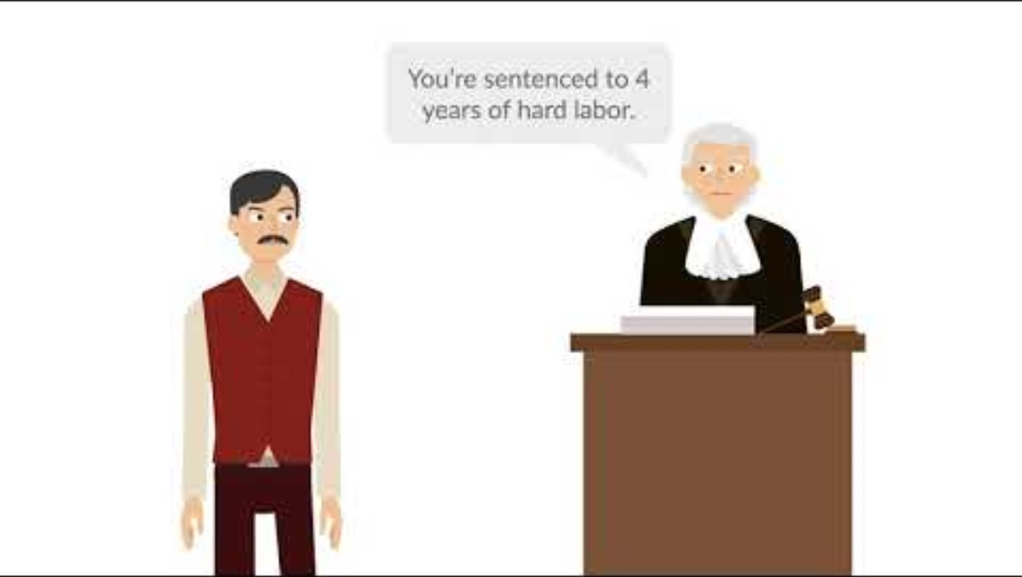
Worcester v. Georgia Case Brief Summary

Slide 9
Worcester v. Georgia Discussion
Why is this court case important?
Did this decision reverse the decision made by the Supreme Court in Cherokee Nation v. Georgia in 1831?
Based on the video, how do you think Worcester v. Georgia (1832) impacted the legality of the Indian Removal Act of 1830?

Slide 10
Take-Home Essay
Write a 500 to 1,000-word essay explaining the federal and state governments’ motivations for the forced expulsion of Native Americans from Georgia and the consequences of this policy on those Native Americans using only primary sources.
Some websites where you can find primary sources for this assignment:
https://www.loc.gov/
https://www.archives.gov/
https://americanindian.si.edu/
https://gahistoricnewspapers.galileo.usg.edu/
https://www.georgiaarchives.org/
https://www.atlantahistorycenter.com/learning-research/search-the-collections/
https://www.libs.uga.edu/scl/research/collections
https://digitalarchives.columbusstate.edu/
https://digital.archives.alabama.gov/
https://da.mdah.ms.gov/browse-all
https://www.georgiahistory.com/research/search-our-collection/

